Slide 1
Shame and Shamelessness in the Works of Nielsen and Pablo Llambias
- Two opposite directions

Slide 2
To be Somebody (instead of Nobody)
Nielsen started out as an awkward, out of place, skinny young androgynous man without any formal education from a lower middle class family in Jutland
But after seeing a television show, with two famous poets, he has a revelation – an epiphany: He discovers that he can be “somebody” be a part of “history”, if he becomes a poet.
“I thought about giving him a signed copy of the journal that contained my two poems, but it was – aside from the table, the chair and the mattress – the only really private I had, without it I was once again nobody, and that I did not want be” (Mine møder: 17, my translation, my underlining)
A quest he would pursue with all means and in more radical (and shameless) ways than any other Danish artist.

Slide 3
The Tipping Point
“Claus Beck-Nielsen (1963-2001). En biografi” (2003, his own biography) became the artistic tipping point.
After a failed relationship 5 1/2 years (starting 1995) resulting in a daughter (1998). He realized he could not be a “subject” in a normal sense. Or, rather, that he was turned down as one.
“Nobody in my family has ever divorced” (En biografi: 187)
He had been “Seen” asa human being and been dumped in 2001 (“After the catastrophe in 2001”. En biografi: 209 ). What to do?
“It was only a matter of time before Claus Beck-Nielsen had to get out of this world. He was simply unbearable to live with” (“En biografi: 161)

Slide 4
The Solution
He decided never to be “seen” as a human being, a subject, again.
At the time, he only had a few, rather insignificant publications in the portfolio, so the only option left was to become “somebody” the career: To become a great writer.
“A human being only attains meaning, thus significance, if somebody writes about it and publishes it’s biography” … it is proof, not only that you exist, but that existing has significance, thus meaning” (En biografi: 165)
“He (the writer, my future to be real me) was hidden behind…” (Mine møder: 40)

Slide 5
To Be Seen, but Remain Unseen
Nielsen’s strategy became to hide behind different pseudonyms and author-personas, for example:
Helge Bille, clausbeck-nielsen.net, Das Beckwerk, Nielsen, Søster Nielsen, Madame Nielsen (etc.)
He was increasingly “seen” as a great writer (“the writer, my future real me”), but as a subject he had dissolved into a polyphonic pseudonymity, like that of Kierkegaard’s.
“But who, then, am I? (…) Let no one ask about that (…) Moreover, I am not worth asking about, for I am the least of all, and people make me very bashful by asking this question. I am pure being and thus almost less than nothing. I am the pure being that is everywhere present but yet not noticeable, for I am continually being annulled” (Stages on Life’s Way, final paragraph of “In vino veritas”: 86, Hong translation)
Or like Pellegrina Leoni (Blixen/Dinensen) after the opera-fire

Slide 6
How To Have your Cake and Eat it Too
He, himself, as a subject, with a particular name disappeared, from his works
While THE REAL PEOPLE AROUND HIM OCCUR WITH THEIR REAL NAME – AS SUBJECTS – IN HIS BOOKS
Without being able to control their story. A story that is put out in public by this seemingly subject-less writer-persona.
At the same time, it is “the flesh and blood author”, who in end gets all the credit: Book readings, interviews, literary prices and thus becomes a part of “history” (a “somebody”)

Slide 7
Suverænen / The Sovereign
Thomas Skade-Rasmussen became the main character in The Soveregin against his own will. On the cover of Suverænen we find a quote by Rasmussen:
”From the very beginning it has been all about going from the universal to the particular”
This is Rasmussen’s artistic ideology and it forms, which forms the opposite movement of Nielsen’s (that goes from the particular to the universal)
Nielsen thus makes himself Rasmussen’s Nemesis, by writing about Rasmussen as a particular, a subject, in the book without Rasmussen’s consent.
Shamelessly against Rasmussen’s own will, while his own subject is hidden under the pen name ”Das Beckwerk” and the novel persona, the anonymous surname ” Nielsen”

Slide 8
Nielsen and the Question of Shame
The categories (except the category “Social Shame”) follow Gerschen Kaufmanns map of shame (1998 from Cullen Weston 2010: 122)
Social Shame: The awkward, shy, lower middleclass, young man from Jutland: Shame with regard to social class.
Body (Gender) Shame: For being an abnormal skinny, androgynous man with a high pitched voice): Shame with regard to body/gender ideals.
Relational Shame: The divorce : “nobody in my family had ever divorced”. Shame with regard to the need for interdependence.
Emotional Shame: To be have been “Seen” in the love meeting, then dumped. Shame with regard to not being a loveable subject.
Professional Shame: To be an insignificant writer (not much worth of “biography”), thus meaningless and non-existing. Shame over not being “somebody”. Not being perfect.

Slide 9
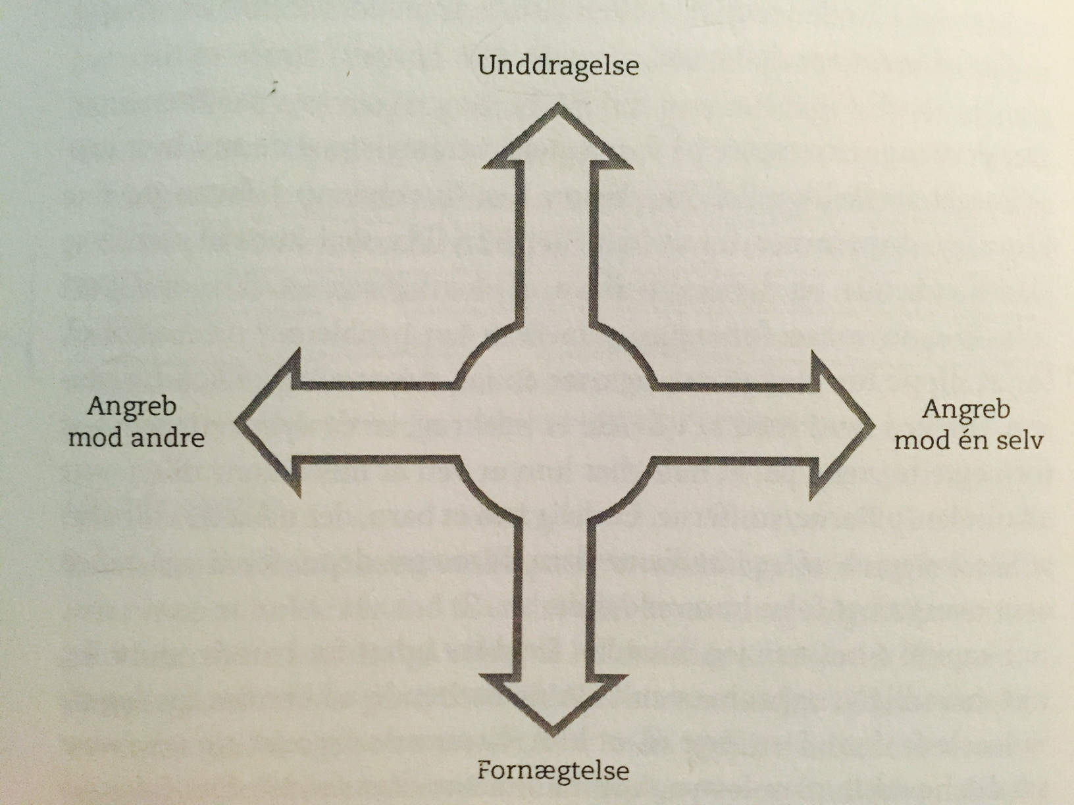
Reactions to Own Shame
“The Defense Compass” (Nathanson 1992).
Unddragelse: Evasion
Angreb mod en selv:
Self Accusation (attack)
Fornægtelse: Denial
Angreb mod andre:
Attack on others

Slide 10
Nielsen and Shame: The Defense Compass
Evasion: The Pseudonyms/Perfectionism: His huge artistic production as a shame compensation.
Attack on Others: Thomas Skade-Rasmussen (his best friend), Christina Hesselholdt (his former wife) Hans Otto Jørgensen (his former wife’s new husband). Narcissistic Rage. Revenge. Passing on Shame.
Contempt: Thomas Skade-Rasmussen’s eating habits, desire for women, artistic ideology (projections of own shame)
Self Accusations: We do find hem, but always hidden behind pseudonyms and character-personas, e.g.:
“Nielsen believes that he believes. But in reality he does not believe in anything … Nielsen is the exemplary Puritan … Nielsen hates “People”, not because they are worthless, he just hates them, because they do not do as he tells them to do … Tweet, tweet, he says. He has not come to defend the freedom of the Iranian People. He has come to confess his sins in the eyes of the world. It is me! He says. Tweet tweet! Je m’accuse” (Store Satans Fald: 77-78, 141, 191-92).

Slide 11
Turning Shame into Gold
“Now the catastrophes, the most embarrassing situations and my biggest losses, everything that was not supposed to have happened at any price, but did happen, what I hold dearest and would not have been without” (Mine møder: 130)
It is the collection of failure, humiliation and embarrassment (shame), which is the very fuel that Nielsen’s art lives from
His authorship the most prominent example of a shame-driven authorship in Danish Literature
Shamelessness is always there, as the dark, other side of coin, when writing about shame (your own, as well as others). But Nielsen is able to shame others, a remain hidden at the same time

Slide 12
Pablo Llambias
Opposite movement with regard to: Fiction, Reality, Subject and Shame
1997-2011: Llambias a prolific and acclaimed writer of fiction (in almost any genre). Traditional separation: An author who writes fiction. His real name on the cover, but not in the narrative.
Until the trilogy 2011-2013: “Monte Lema”, “Hundstein” and “Sex Rouge” (1500 pages of sonnets)
The trilogy is about his midlife crisis: Anxiety, depression and sense of failure and SHAME.
Real events, real people are mentioned. But they have read and and approved before publication

Slide 13
Llambias and Shame
Opposite of Nielsen, where the word “Shame” is rarely mentioned, we find the word everywhere in Llambias sonnets.
Also a strong desire to “Seen” too – opposite of Nielsen.
Here some passages from “Hundstein” (2011) (English translations are mine)

Slide 14
Desire to be Seen
“I have a big desire to be a human being in relation to somebody” (5)
“I love that she reads my sonnets and see me as who I am” (45)
“So private and yet so open. I want everybody to know, who I really am. At the same time I want to withdraw and get away” (173)
“I want to touch people like Knausgård does. I want to give them an emotional experience. Also to stand out as who I am and talk about anxiety and what it is all about” (132)
“We talk about the trial between Thomas Rasmussen and Claus Beck-Nielsen. She asks: Does that mean that everyone is at risk for becoming a part of a fictional work. Yes, is my answer … Don’t I have an ethical obligation with regard to her. Yes, most people would answer. That is why I will show her everything before it is published. To get her opinion.” (309)

Slide 15
Shame in Hundstein (selected)
“I would be embarrassed if I was to be seen with T. in Copenhagen. It would be a disgrace (“skamplet”) for me as a man to have such a young girlfriend” (Hundstein: 23)
“I am up until 3 o'clock in the morning and goes to bed at the same time as my oldest son … It is utterly pathetic and I am ashamed (“Jeg skammer mig”) (67)
“The party will be a gathering of wealthy, established adults … I hope I will not feel completely out of place, like a child” (91)
“My youngest son has a friend over. The hallway is messy, so are all the rooms. The toilet is dirty and there are papers everywhere, empty toilet rolls and dust. I am ashamed of myself and my life” (249)
“I have been visiting my parents … What would happen if I told them, how I really feel … I want to hide my seek leave from them. So they won’t be ashamed of me. (253)
“I am ashamed of myself. I am not a good son. I am not a decent person” (62)
“My life is so detestable. It has no pride. It is full of shame. I am ashamed of being me” (125)

Slide 16
What is Shameful?
What is it that is shameful in the case of Nielsen and Llambias?
Nielsen: Social Class, Body (not in Llambias’ case), Divorce, Career
Llambias: Young girlfriend, single life, not being in an” established” family situation, not being a “proper dad”

Slide 17
The “Big Other” and Male Identity
What does the works say about shame, male identity vs. the existing norms/ideals (“The Big Other”, “Dem fra Købmagergade”)
Source of Shame: Body, Social Class (Nielsen), Divorce/children (both), to be seen as subject/human being behind the professional persona (Llambias).
SO: A man has to be handsome, a successful agent in the right social environment and a successful professional and provider.
This is the male version of THE BIG OTHER OF POSTMODERNITY
– and not that different from late 19th century ideals.
The men of postmodernity is just as trapped in outdated stereotypes than women (if not more)

Slide 18
Wining?
“Leonora Christina Skov is bashing Knausgård’s Min kamp, which I think is an excellent book. Many does like her. Anna Grue and her husband Jesper Christiansen support her critique on Facebook. Many can’t stand these heartfelt (“inderlig”), wining utterings (“udladninger”). I will come to divide the waters but that is a risk, I have to take. I will not back off from this type of literature” (34)
What if a woman had written “Min Kamp” – or “Hundstein”? Would we ever think about using the word “wining”?

Slide 19
Breaking the Male Stereotype of The Postmodern Big Other
Llambias shows a desire to:
Be able to show weakness, to be a “human being”, not just a (professional) man; to live his life as a single man, not following the ideals of the nuclear family (son goes to bed before father, everything is nice and tidy); to not feel ashamed for not being able to talk about pension plans with successful, wealthy middle-aged people, etc.
Nielsen’s solution is to disappear as a private (male) subject and ONLY to be seen as the great artist. He becomes pure ambition: The CEO of “Das Beckwerk” Enterprises.
What matters is how much, what impact, how many literary prizes. The norms of the Competition State. Dehumanization.

Slide 20
Upbuilding Nietzsche
"Whom do you call bad?
- Those who always want to put to shame
What do you consider most human?
- To spare someone shame.
What is the seal of liberation?
- To no longer being ashamed in front of oneself."

